Slide 1
Unit Six – Neck & Spine Injuries
Lesson Three: The Brachial Plexus

Slide 2
Introduction
What do you know about nerves?
What is a nerve root?
What happens when a nerve is compressed?

Slide 3
Objectives
Identify the soft tissue anatomy of the neck & spine
Identify the five different nerves that make up the brachial plexus
Explain the difference between dermatomes & myotomes

Slide 4
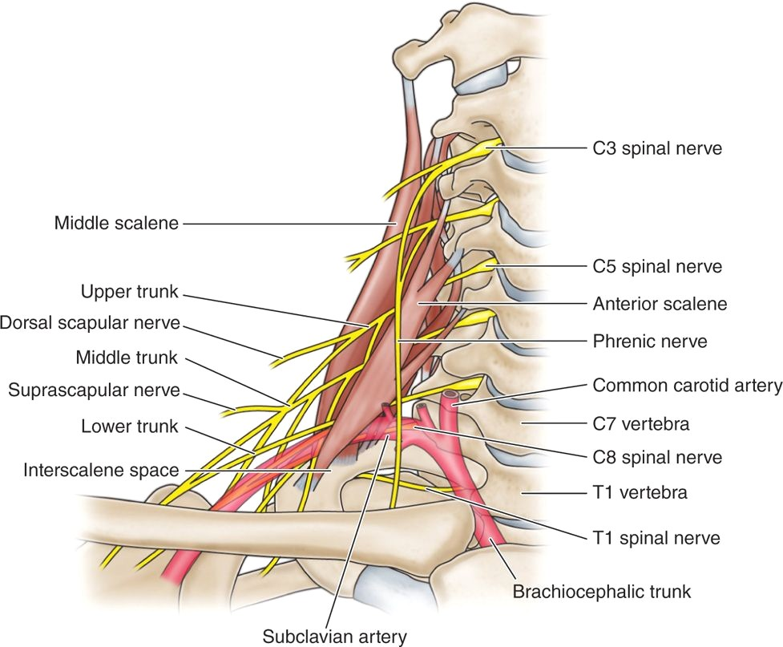
Soft Tissue Anatomy – Cervical Nerve Roots
8 Cervical Nerve Roots
C1-C4 make up the Cervical Plexus
These roots have dermatomes at the occipital, supraclavicular, shoulder, & upper thoracic regions
C1 helps to innervate some neck flexors

Slide 5
Soft Tissue Anatomy – Brachial Plexus
C5-C8 & T1 make up the Brachial Plexus
The nerve roots give dermatomes & myotomes to some of the shoulder, all of the arm, & the hand
There are different segments that the roots are broken up into: roots, trunks, divisions, cords, & branches
The ANTERIOR portions of the roots send the brain motor information while the POSTERIOR portions send sensory information

Slide 6
Soft Tissue Anatomy – Brachial Plexus

Slide 7
Soft Tissue Anatomy - Dermatomes

Slide 8
Soft Tissue Anatomy - Dermatomes

Slide 9
Soft Tissue Anatomy - Myotomes
Axillary Nerve: abducts arm, externally rotates arm
Radial Nerve: extends & flexes forearm, supinates forearm, extends wrist & fingers, innervates the thumb
Musculocutaneous Nerve: flexes the arm & forearm
Ulnar Nerve: Flexes wrist & fingers, adducts & abducts fingers, adducts thumb, hypothenar & midpalmar muscles
Median Nerve: pronates forearm; flexes wrist, fingers, & thumb; thenar & midpalmar muscles

